Slide 1


6CCS3PRJ Final Year Visualization Quality Metrics: Design, Implementation and Evaluation
Yuchen Wang
ID: k19074714
Notes:
Hi, I am Yuchen Wang and my project is Visualization quality metrics: design, implementation and Evaluation. This project is designing, implementing and evaluating the quality metrics of data visualisation submissions from master students at Newcastle University. The quality metrics implemented are designed to explain the performance of the data visualisation submissions.

Slide 2
Introduction
Human marks:
1. Fit to task: It is to assess if the impact, certainty and key areas can be identified easily and quickly in the visualisation.
2. Use of Visual Channel: It is for assessing the blocks’ shapes, sizes and colour bright- ness.
3. Gestalt Design Principles: It is to assess the layout design of this data visualisation like alignment and proximity.
4. Use of Colour: It is to assess the colourfulness and the colour aesthetics.
5. Use of Interaction: It is for assessing the effectiveness of the interaction part.
6. Use of Language: It is for assessing the quality of language used and the layout arrangement
of elements in a design concerning the visual elements in the data visualisation.
7. Technical Aspects: It is to assess if the visualisation is fit to screen sizes and if the visualisation is reliable and readable.
Notes:
The dataset involves the submission data visualisation which is fully anonymous and the human marks per submission. The marking process includes 7 different aspects:
There are quality metrics designed for assessing each marking criteria except for the Technical Aspects.

Slide 3
User Group
Student
Markers
Data visualization designer
Notes:
In a short term, the automated quality metric evaluation could help the students to improve their data visualization coursework. And markers could gain some objective advice from the metric values to evaluate or mark the data visualization coursework.
In a long term, it could benefit the data visualization designers or the people who are willing to improve their data visualization.

Slide 4
Evaluate the quality metrics
Pearson correlation coefficient( R-value)
P-value: threshold in this project is 0.1
Metric values (Machine)
Correlation
Mark
(Human)
Notes:
In this project, we are using the human mark and the metric values calculated by the algorithms and models to compute the correlation values.
There are two values presented to validate their relationship: Pearson correlation coefficient and p-value. The Pearson correlation coefficient will be called as r-value in the next slides.
r-value can only reflect the linear relationship, the value is between -1 and 1. If the value is 0, then there is no linear relationship, if the value is 1, it indicates the strongest positive relationship and vice versa.
A very small p-value, usually under 0.05, would indicate that the result is statistically significant, which means the result is not produced randomly or by coincidence. In this project, due to the small sample size, the threshold is set to 0.1.

Slide 5
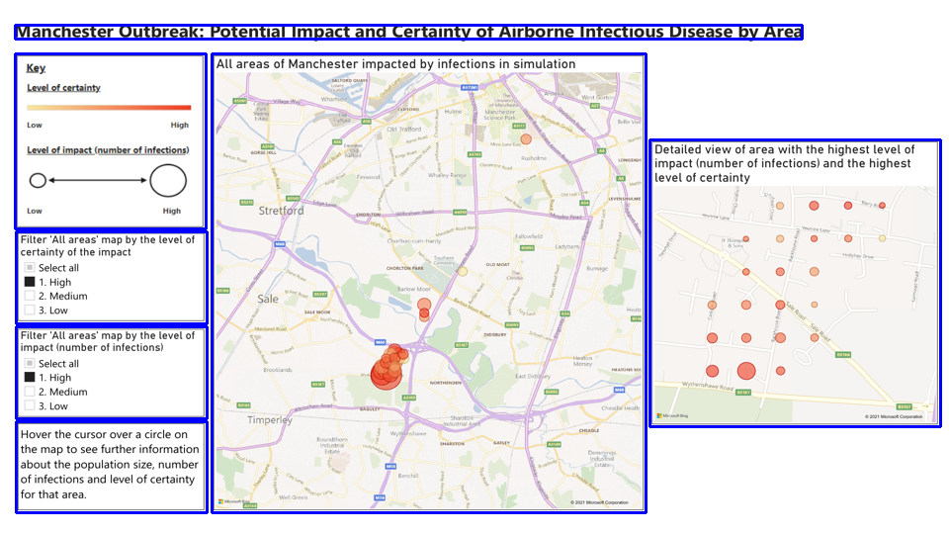
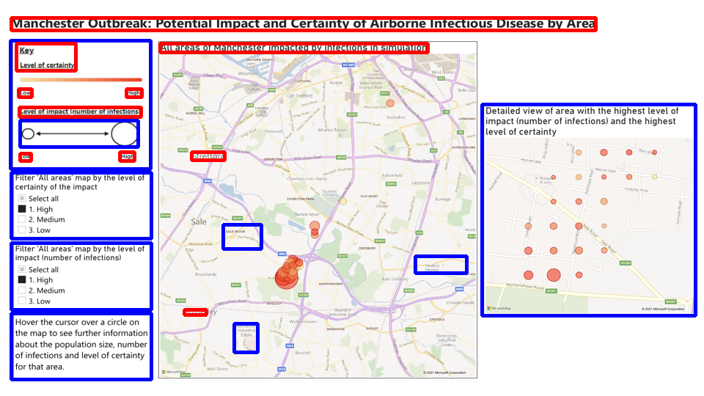
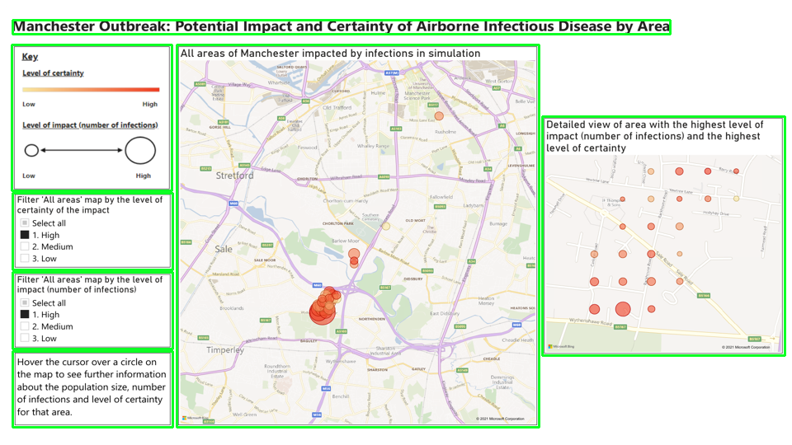
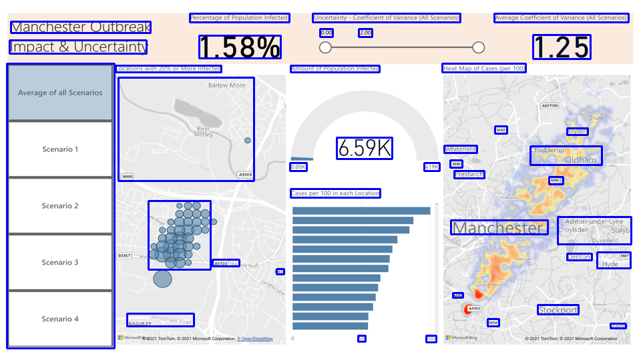
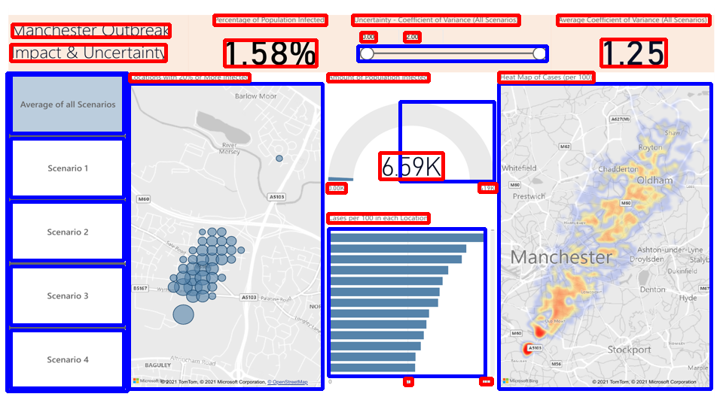
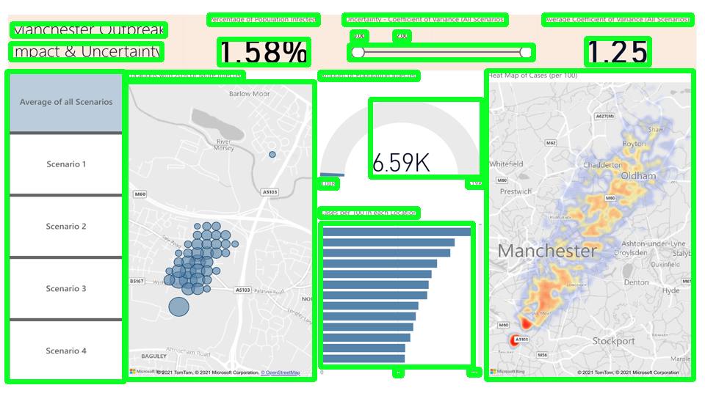
Image Segmentation Technique
Merge Algorithm
Version 1(contour-based)
Version 2(UIED*)
Version 3(combined)
Example 1:
+
(Version 1 is better
than version 2)
=
Merge Algorithms
Example 2:
+
=
(Version 2 is better
than version 1)
*UIED: User Interface Element Detection (https://dl.acm.org/doi/10.1145/3368089.3417940)
Notes:
There are some quality metrics are using image segmentation technique. We implemented several versions. Version 1 is detecting the visual blocks based on the contours. From example 1, the visual blocks with clear contours are all detected. But in example 2, the visual blocks without clear contours are not detected.
Version 2 is using the toolkit to detect the element on the GUI design image. This version combines machine learning and traditional computer vision. For more information about the UIED, please visit the link below. From Example 2, we could see that the performance of version 2 is much better than the performance of version 1. But in example 1, version 2 could misdetects some visual blocks which version 1 can easily detect. The reason why version 2 fails to detect elements in some visualisations is unknown, but we could use version 1 to make the image segmentation more accurate.
So the final version is to combine the performance of version 1 and version 2. But the visual blocks detected by two versions need to be first merged before use. So a merge algorithm is applied to get the merged positions, removing any redundant visual block positions. The visual blocks detected by the final version of image segmentations have no intersections.

Slide 6
Metric Correlation Results
Metric | Short Introduction | Human Mark | R-value | P-value
Saliency | Human attention | Use of Language | 0.432 | 0.073
NTTR* | Non-text areas / text areas | Fit to Task | -0.391 | 0.114
Text Coverage | Text areas / whole image areas | Fit to Task | 0.401 | 0.098
White Space | Un-covered areas / whole image areas | Gestalt Design Principles | -0.03 | 0.989
Colourfulness | Predict Colourfulness | Use of Colour | 0.624 | 0.006
Text Similarity | Submission <- Text similarity ->requirements | Use of Language | 0.080 | 0.754
WAVE* | Colour Preference | Use of Colour | 0.425 | 0.079
*WAVE: Weighted Affective Valence Estimates
*NTTR: Non-Text and Text Ratio
Notes:
Here is a table of correlation results for all quality metrics that are implemented in this project.
Only Saliency, text coverage, colourfulness and WAVE have a p-value that is under the threshold of 0.1, which means only these metrics have meaningful R-values.
Some quality metrics are designed to explain several human marks, but here we only choose to present the one that with the lowest p-values among all human mark criteria.

Slide 7
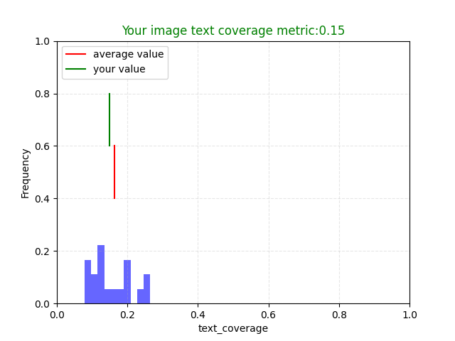
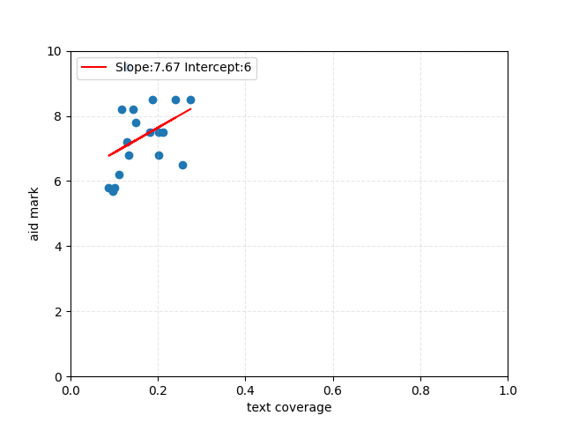
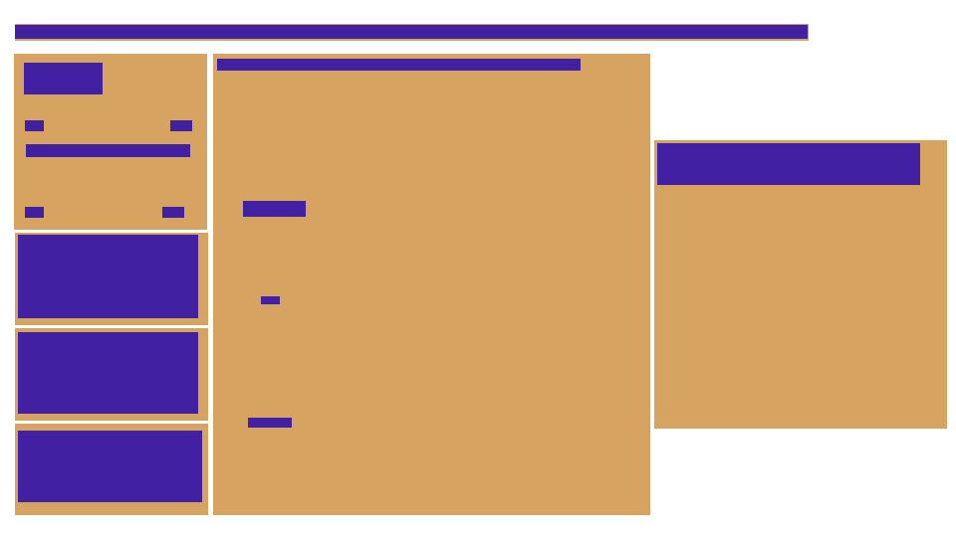
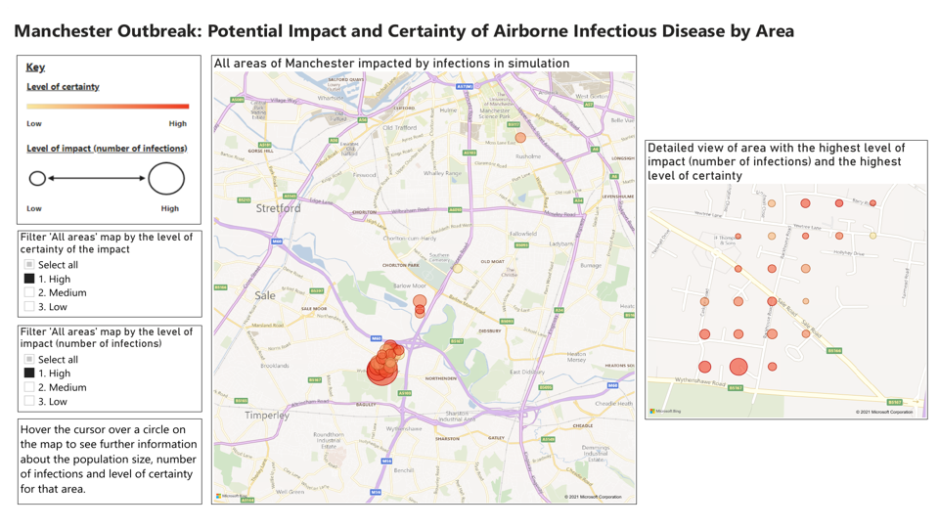
One Scenario: Text Coverage
Text Coverage: positively correlated with the fit-to-task mark (r-value:0.401)
Metric Value
Metric Correlation
submission
Non-Text and Text Distribution
Notes:
Here is one example of evaluating the submission using the quality metric. The quality metric is text coverage, which is positively correlated with the fit-to-task mark and the p-value is below 0.1.
The image on the bottom left is one of the submissions. And the image on the bottom right is the non-text and text distribution. This image was processed using the position information from the non-text and text ratio quality metric. But we put it here with text coverage because it could see clearly the layout relationship between the non-text blocks and the text blocks.
The image on the top right is a linear regression graph, the x-axis is the metric value and the y-axis is the fit-to-task mark. The red line on the graph is the linear regression line that predicts the relationship between metric value and the human mark. We could see that it is a positive relationship and it also could tell from the r-value whichis also positive. The bar chart on the top left shows all submissions’ metric value frequency distribution. The green line is the value of the submission on the bottom and the red line is the average value. We could see that the submission value is below the average value.
So to evaluate this submission using the quality metric value, we could suggest the student have more text areas by putting more text in the white space areas or making those existing text areas bigger to increase the text coverage value. The reason may be text coverage could explain the text visibility or more text could help explain the data. But the true reason why text coverage values have a correlation with fit-to-task mark needs further exploration and comments from human markers.
But we need to note that the r-value is 0.401, which means text coverage metric value could only explain around 40 percent of the human mark so the relationship between text coverage values and the human mark is moderate.

Slide 8
Thank you
Notes:
This is the end of this presentation, thanks for listening!

